Slide 1


PRESENTATION
By Team

Slide 2


GRAPHHOPPER DIRECTIONS CLI APPLICATION
Course: Software Engineering
Team Members:
Matyakubov Azizbek, 12214750
Klechshev Timur 12235650
Bekzhanov Tariel 12225274
Sobitkhonov Kudratkhon

Slide 3


OBJECTIVE
Build a functional CLI application to get real-time routing directions and location data using external APIs.

Slide 4

TECH STACK
Language: Python
APIs: Graphhopper Geocoding and Routing API
Libraries: requests, dotenv, prompt_toolkit, colorama, tabulate, json

Slide 5

IMPLEMENTATION OVERVIEW
User inputs two locations
Geocoding converts to coordinates
Vehicle type is selected
API returns directions and distance
Data saved in history JSON file

Slide 6

TEAM CONTRIBUTION
Aziz | CLI interface, input validation, menu system
Timur | Geocoding logic, API integration
Tariel | Route fetching & display formatting
Kudratkhon | Trip history saving and viewing

Slide 7

HIGHLIGHTS

Slide 8
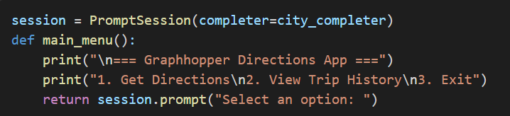
CLI Interface & Menu System:

Slide 9
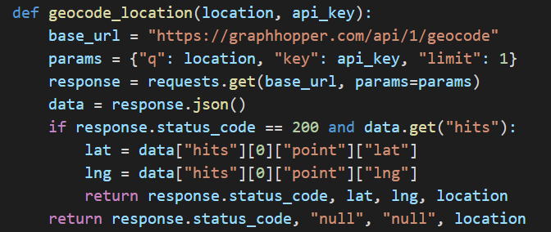
Geocoding Implementation:

Slide 10
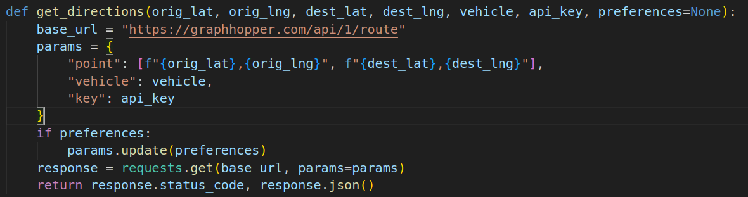
Routing & Display:

Slide 11
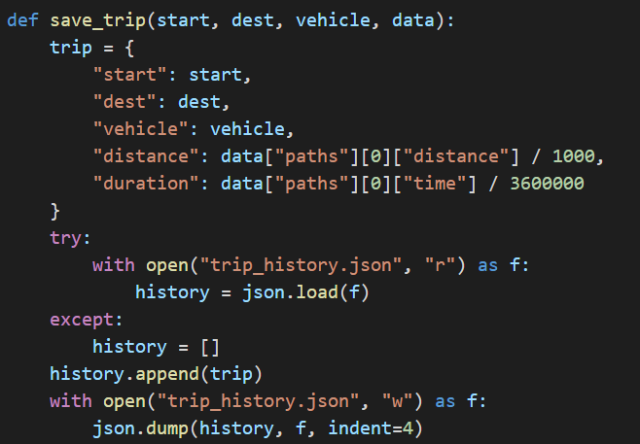
Trip History Management:

Slide 12

CHALLENGES
Graphhopper API rate limits
Handling invalid inputs & missing data
CLI user experience tuning
Parsing complex JSON responses

Slide 13

FUTURE ENHANCEMENTS
Add map visualization using Folium or web view
Export trip history to CSV
Create a GUI version using Tkinter or PyQt

Slide 14
CONCLUSION
"We built a lightweight, extensible CLI tool that uses real-time geocoding and routing APIs to deliver a functional travel assistant. It helped us understand API integration, CLI user experience, and data handling."

Slide 15
THANK YOU

